Slide 1
CAR INSURANCE
This involves Car Insurance data set that is about the annual insurance data of a company

Slide 2
The stake holder is the insurance company
The problem we are solving is determining the number of people who make insurance claims
The outcome column indicates 1 if a customer has claimed his/her loan else 0.
The data has 19 features from there 18 of them are corresponding logs which were taken by the company.

Slide 3
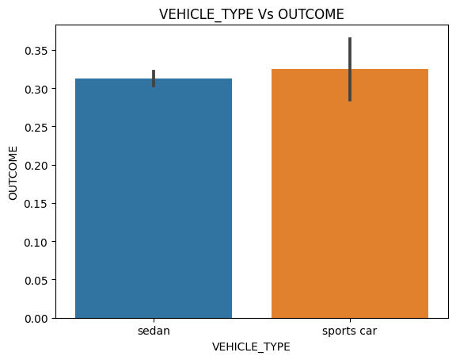
Visual for Vehicle type Vs OUTCOME
The above visual shows us that people who own sports cars are more likely to claim for insurance. This could be due to the fact that sports cars are more likely to cause accidents because they are fast and move at high speeds and are more likely to cause accidents

Slide 4
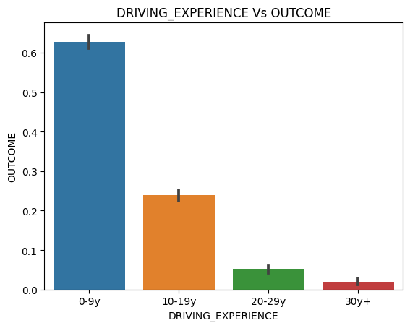
Visual for Driving Experience Vs OUTCOME
The above visual shows us that as the drivers experience increases , the outcome reduces .
This means that more experienced drivers are less likely to make insurance claims

Slide 5
Explanation of false positive and false negative impact on stake Holders
False positives :213
False negatives :244
Basing on the above information , this means that the insurance company isnt able to 100% find out the information about the outcome of people who applied for insurance and those that didnt

